Slide 1
BANKING SYSTEM USING BLOCKCHAIN
MADE BY:
Avnish Singh 104
Rajat Kumar 94
Navneet Lochab 97
Pushan Vema 114

Slide 2

PROBLEM STATEMENT
Today, the Indian banking industry is faced issues and problems such as increase in costs of operations, increasing susceptibility to fraudulent invasion on centralized servers and challenges in assuring transparency.
All this,firstly because most of the banking transactions are from opening customer accounts to make it global payments it may require comprehensive manual processing and documentation, it includes costly intermediaries and is time consuming as these transactions need to be certified by various participants at various stages in time causing the delay
Thereby resulting in almost lack of fraud and deceit proof real time solution.

Slide 3

SOLUTION
Banks are regularly exploring new ways to execute transactions earlier for an enhanced customer service, while assuring cost efficiency in its operations and ensuring transparency to customers and regulators.
For this, Blockchain probably provides a solution for banks as it intrinsically helps eliminate intermediaries, maintain immutable log of transactions and also facilitates real-time performance of transactions. This could potentially reduce the diminishing costs of manual work, and leading to enhanced banking transaction.

Slide 4

WHAT IS BLOCKCHAIN ?
A blockchain is a shared, distributed, and permanent database shared among multiple nodes on a computer network. They record data in a way that makes it probabilistically impossible to modify or hack the system.
Specifically, as its namesake, blockchains record data as a chain of blocks. Each block contains a group of transactions, which could be transferring assets around the network, or updating the information stored on the blockchain.

Slide 5
WHY BLOCKCHAIN ?🤔
Decentralised Trust :
The primary advantage of blockchain is its method of verifying and tracking transactions—it enables individuals and organisations to process transactions without the need for a third party or a central bank.
Enhanced Security :
Once data is recorded in a block, it cannot be altered retroactively—this makes blockchain inherently secure.

Slide 6
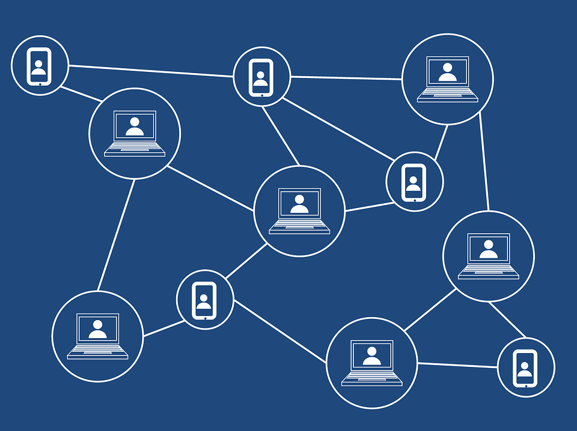
Decreased Costs : By leveraging the distributed ledger approach to form a system that decentralises trust, banks are able to decrease transaction fees significantly by eliminating third party intermediaries and overhead costs for exchanging assets.
Increased Efficiency : Blockchain eliminates the risk of errors and duplication, and is consequently ideal for refurbishing a range of digital processes.

Slide 7
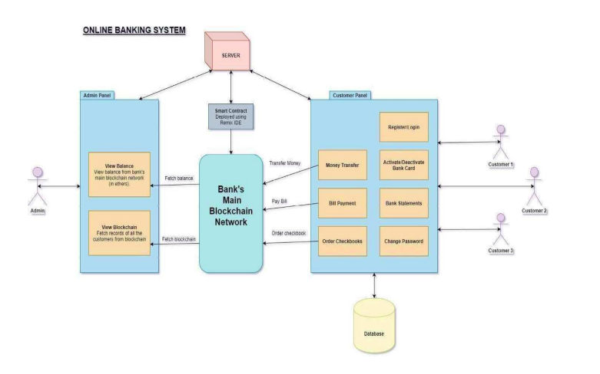
PROJECT OVERVIEW USING
USE CASE DIAGRAM

Slide 8
Algorithms Used
Consensus Algorithm
> Proof of Work
> Proof of Stake
>Proof of Capacity
Time Stamp Algorithm
Hashing Algorithm(SHA-256 Algorithm)

Slide 9
Key Features of the Project
Bank Statement
While transacting money from one account to another, the most important thing is to maintain a ledger ,to keep a record of money transferred and received. The Bank Statement provides a comprehensive view of cash flow . Firstly, It displays the personal details of user's account and according to date , it maintains a small table displaying the date when the money is transferred ,sender's account number, and receiver's account number and the amount that is being transferred .
2. Bill Payment
Bill payment comes with the facility to pay personal bills through portal to several government bodies as well as telecom services. The user has to select the company to which bill is to be paid , has to enter amount to be paid and from which account money is being paid.
3. Peer to Peer Transfer
Peer to Peer (P2P) payments is a mechanism through which the user can transfer funds from his bank account another individual's account via the digital medium i.e. Internet or a mobile device.

Slide 10
Supporting Technology Used
HTML
The HyperText Markup Language or HTML is the standard markup language for documents designed to be displayed in a web browser.
Css
Cascading Style Sheets is a style sheet language used for describing the presentation of a document written in a markup language such as HTML
JavaScript
JavaScript is a scripting or programming language that allows you to implement complex features on web pages
Rinkeby APi

Slide 11
Additional Features in Major Project
1. Ordering Cheque Book
If the user faces shortage of cheques , user can request through online portal,and can select leaves(cheque pages)according to his/her needs. The bank offers 4 types of leaves i.e 50 pages,100 pages , 150 pages, and 250 pages. User can get the cheque book within 10 days of requesting from portal.
2. Changing Passwords
The new functionality allows user to change password , user has to enter current password and has to set the a new password . Confirming the password by entering it two times .
3. Activation and Deactivation of Debit card
User can activate and deactivate debit card , incase of emergency in the portal , entering user details.

Slide 12
Future Scope
Client security can be enhanced.
Micro services can be introduced for Scalability.
UI can be enhanced .
Loan facility can be introduced in the system , through credit cards .

Slide 13
Thank You

